Slide 1


RF MULTI-CONTROLLED WHEELCHAIR SYSTEM.
NAME: DENZEL MURAGE NGENDO
REG NO: ENE211-0203/2018
SUPERVISOR: S. N CHEGE
PROJECT NO: 052

Slide 2

CONTENTS
2
Introduction
Background
Problem statement
Problem justification
Objectives
Literature Review
Methodology
Results
Conclusion and Recommendation
Budget
Time plan
End
Presentation by Denzel Murage |EEE | 2023 | JKUAT

Slide 3
INTRODUCTION
3
Mobility presents a significant challenge for those with motor disabilities.
motorized wheelchairs, have improved mobility for people living with disabilities.
However, there was still a gap in the independence of these individuals.
Presentation by Denzel Murage |EEE | 2023 | JKUAT

Slide 4
BACKGROUND
4
There is a need for a system that incorporates several methods of movement control.
To cater to; different environments, and independence of these individuals.
The proposed system seeks to improve motorized wheelchairs to have touch, voice, and hand gesture controls.
In addition obstacle detection and avoidance safety feature will be available.
Presentation by Denzel Murage |EEE | 2023 | JKUAT

Slide 5

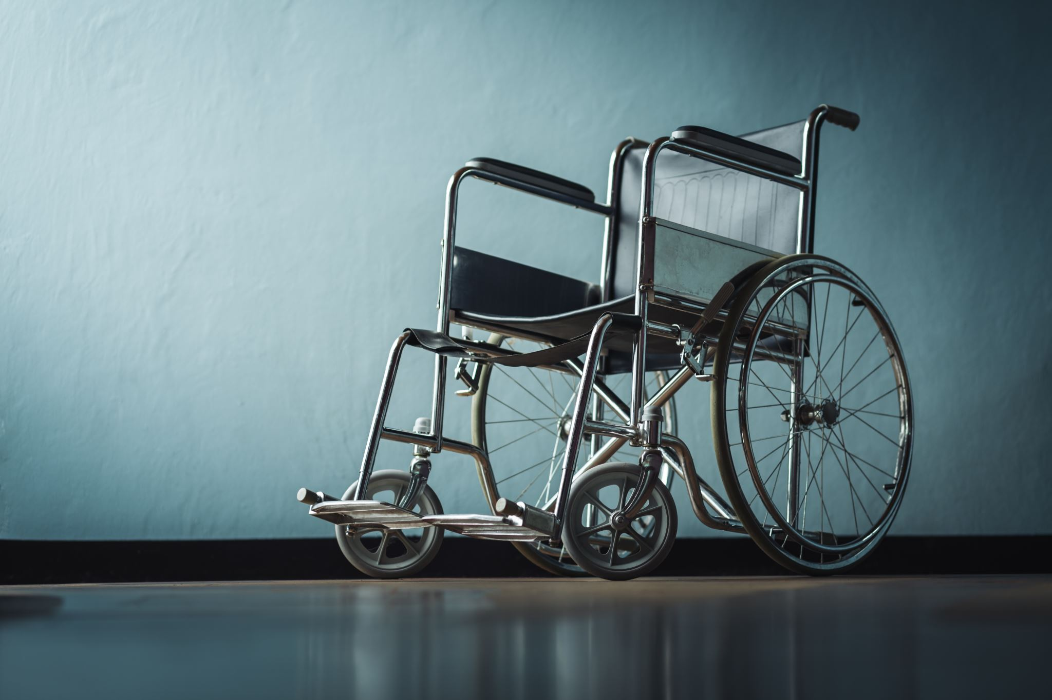

PROBLEM STATEMENT
5
Joystick controls in motorized wheelchairs suffer from drawbacks like limited functionality.
usability issues and high costs hamper the mobility and independence of users.
The use of the joystick can lead to fatigue and repetitive stress injuries.
Controls are prone to damage due to constant force, causing inconveniences and financial burdens for users.
Presentation by Denzel Murage |EEE | 2023 | JKUAT

Slide 6

PROBLEM JUSTIFICATION
6
The proposed prototype is set to overcome challenges as listed for users:
Lack of control options for convenience to users in terms of comfort and autonomy in navigation.
Physical Strain and Fatigue from continuous pushing of joysticks over extended periods of use.
Wear and tear from the physical strain applied on the joystick over time.
Presentation by Denzel Murage |EEE | 2023 | JKUAT

Slide 7


OBJECTIVES
7
Main Objective
To develop a Multi-controlled Wheelchair system enhancing the safety, mobility, and independence of wheelchair users.
Specific Objectives
To design and implement touch, speech, and gesture control interfaces for the prototype.
To integrate safety features like obstacle detection, collision avoidance, and emergency stop controls.
To design an inexpensive system concept.
Presentation by Denzel Murage |EEE | 2023 | JKUAT

Slide 8


LITERATURE REVIEW
8
The multi-controlled wheelchair system incorporates three different navigation modes:
Touch navigation mode.
2. Gesture navigation mode.
3. Voice navigation mode.
Touch mode uses a touch-sensitive display to display the motion options to the user
Presentation by Denzel Murage |EEE | 2023 | JKUAT

Slide 9
LITERATURE REVIEW Cont.
9
Voice mode uses a mic as an input device to issue motion instructions.
Gesture mode uses an accelerometer as its main sensor to issue motion instructions.
other components used include; an ultrasonic sensor, an RF transmitter/receiver, a battery, and motors.
Presentation by Denzel Murage |EEE | 2023 | JKUAT

Slide 10
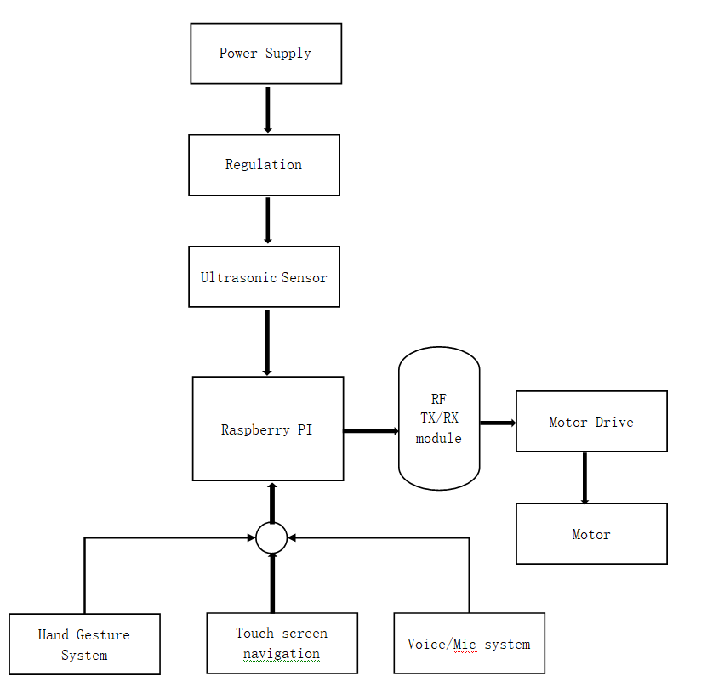
METHODOLOGY
10
System Block Diagram
Presentation by Denzel Murage |EEE | 2023 | JKUAT

Slide 11
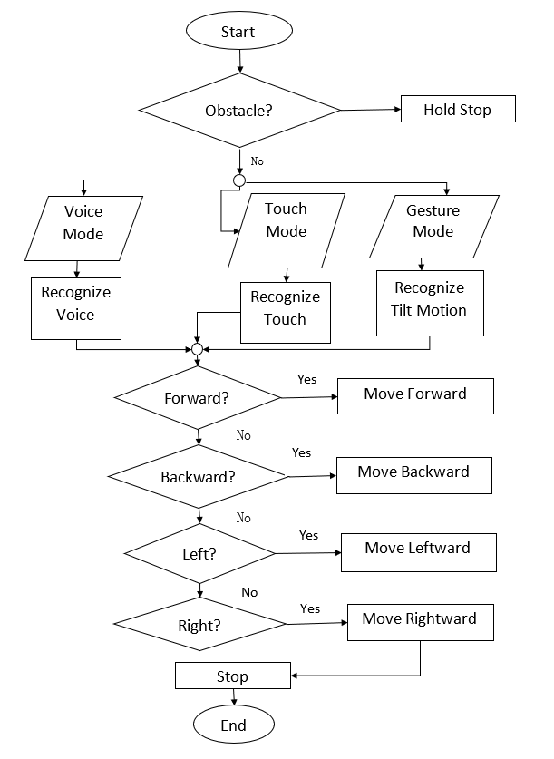
SYSTEM FLOWCHART
11
Presentation by Denzel Murage |EEE | 2023 | JKUAT

Slide 12
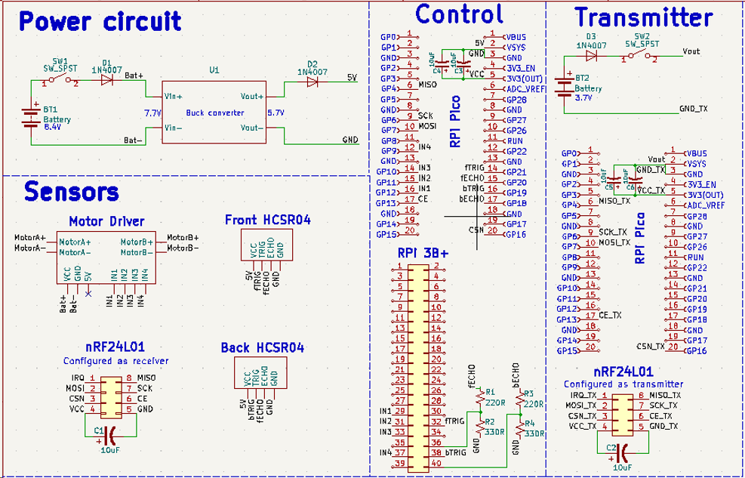
SYSTEM SCHEMATIC
12
Presentation by Denzel Murage |EEE | 2023 | JKUAT

Slide 13
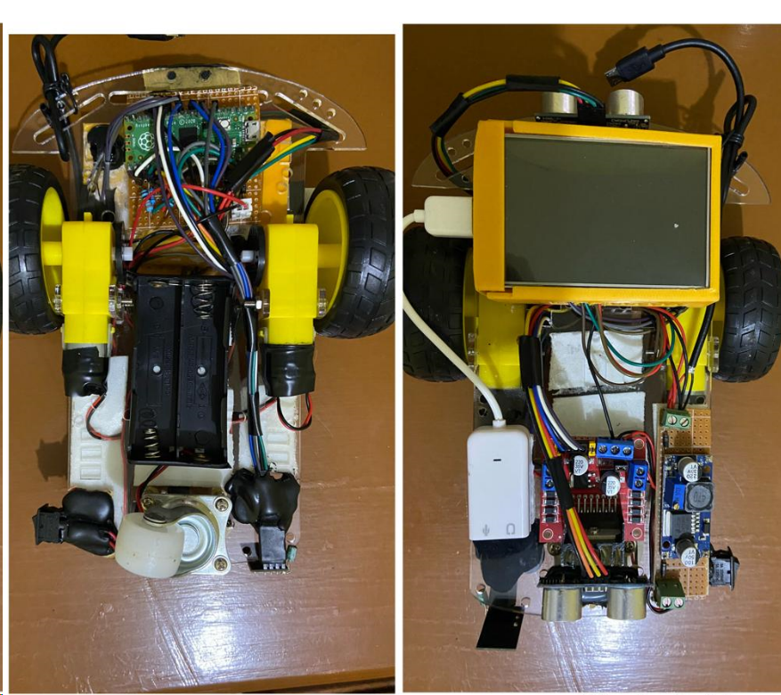
PROTOTYPE SETUP
13
Presentation by Denzel Murage |EEE | 2023 | JKUAT

Slide 14
RESULTS
14
The prototype was to implement touch, voice, and gesture control interfaces.
The prototype was to have an obstacle-detection feature.
The prototype was to have an avoidance feature and emergency stop control.
To be a comparatively inexpensive system.
Presentation by Denzel Murage |EEE | 2023 | JKUAT

Slide 15
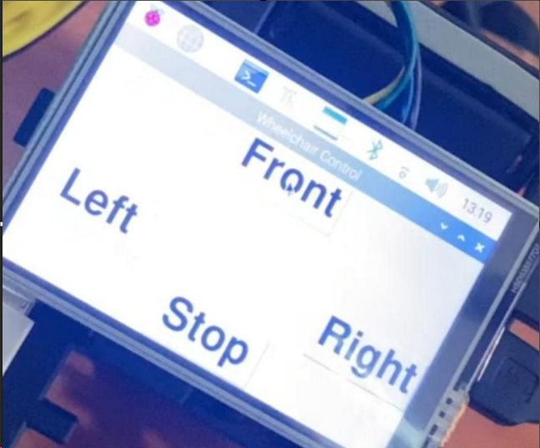
RESULTS
15
The prototype is to implement touch, voice, and gesture control interfaces.
The following is the GUI (Graphical User Interface) of the Touch Navigation.
Presentation by Denzel Murage |EEE | 2023 | JKUAT

Slide 16
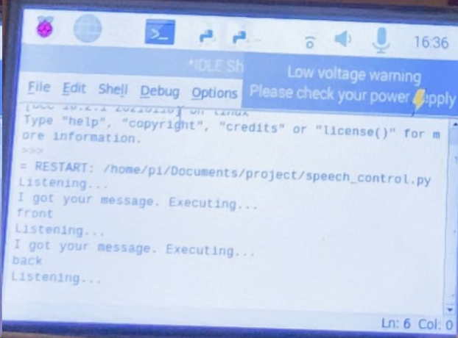
RESULTS
16
Shown below is the response of the voice navigation system after a command has been conveyed via a microphone.
Presentation by Denzel Murage |EEE | 2023 | JKUAT

Slide 17
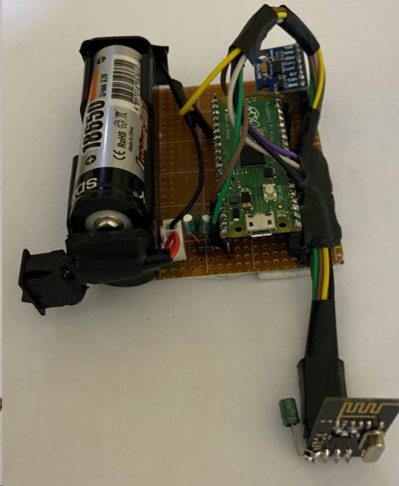
RESULTS
17
Shown below is the gesture input system that helps instruct the prototype of the command the user is giving.
Presentation by Denzel Murage |EEE | 2023 | JKUAT

Slide 18
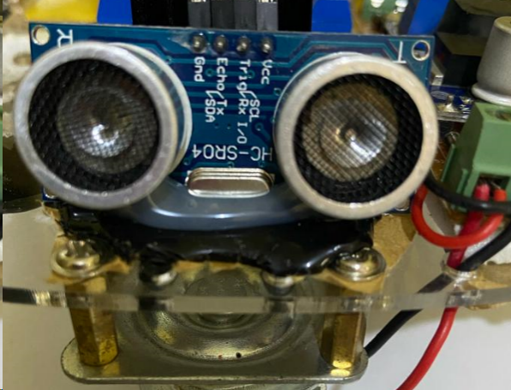
RESULTS
18
Shown below one of the 2 ultrasonic sensors meant to prevent collision by activating emergency stop controls
Presentation by Denzel Murage |EEE | 2023 | JKUAT

Slide 19
CONCLUSION
19
In this project, a Radio Frequency multi-controlled wheelchair was developed to help achieve more autonomy for people with motor disabilities.
The system developed seems to also be a cheaper solution motorized wheelchairs. With this system being used it would make it available to more people than before hence bring a solution to a problem.
RECOMMENDATION
Incorporating a multiplexing and demultiplexing system would be good to ensure the whole system worked seamlessly when it comes to execution of commands to the motor drive.
Presentation by Denzel Murage |EEE | 2023 | JKUAT

Slide 20
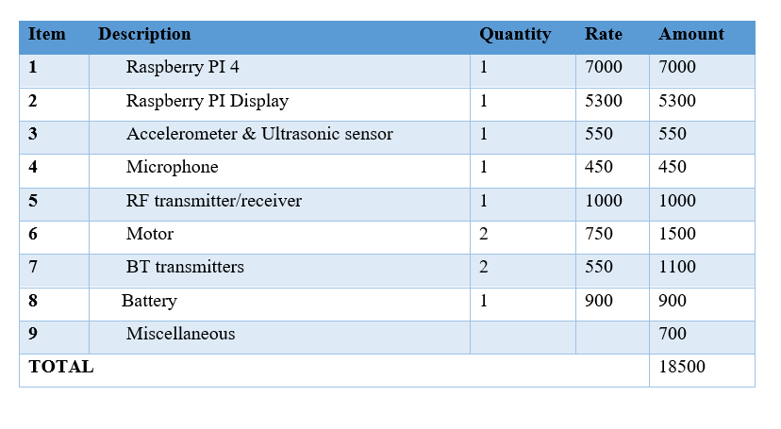
BUDGET
20
Presentation by Denzel Murage |EEE | 2023 | JKUAT

Slide 21

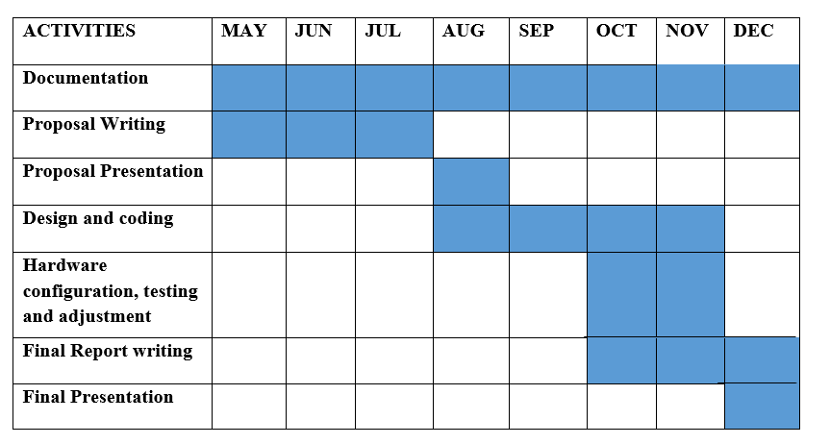
TIME PLAN
21
Presentation by Denzel Murage |EEE | 2023 | JKUAT

Slide 22


22
THANK YOU
EEE | 2023
JKUAT

